Slide 1

Future sales prediction

Slide 2
Introduction
In this project we present detailed description and evaluation of the kaggle future sales prediction challenges.
Training data given in train.csv has 2935849 rows and has 6 columns : date,date_block_num,shop_id.

Slide 3
How do you Predict future sales?
Sales from previous year break the numbers down by price, product, rep, sales period, and other relevant variables, build those into a “sales run rate”, which is the amount of projected sales per sale period.

Slide 4

How to choose sales prediction methods?
Consider your data
Analyse the sale cycle
Determining the value of predictions to the company

Slide 5
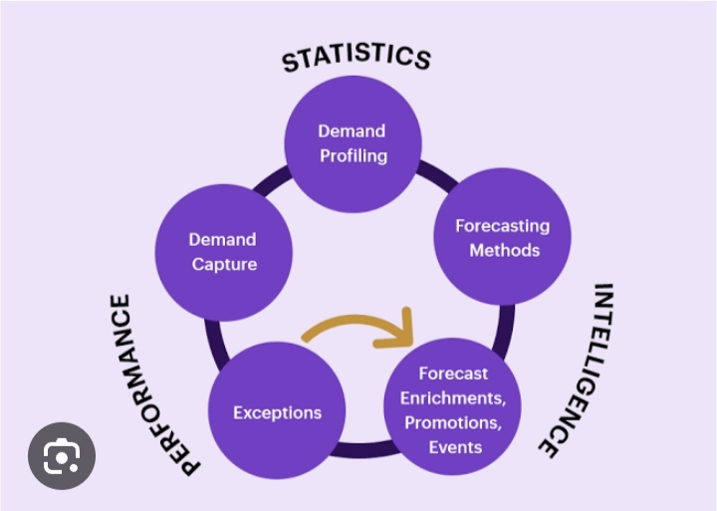
What do sales to next method includes?
Sales Categories
Company
Unit sales for the past months and years
The number of sales that customers cancelled
External factors like price charges
Price projections

Slide 6
Key Metrics used accuracy check in sales prediction
Basic sales metrics for sales prediction
Next level sales metrics for sales prediction
Advanced sales metrics for sales prediction Accuracy

Slide 7
Conclusion
In this work we presented future sales prediction models based on decision tree structures.
Our evaluation showed the best performing model can be achieved through ensembling of LGBM and random forest giving equal weight to each.

